Slide 1
Motivation
Meaning, Maslow’s Hierarchy of Needs, Four Drive Theory of Motivation.

Slide 2
Meaning
The forces within a person that affect the direction, intensity, and persistence of voluntary behavior.

Slide 3
Maslow’s Needs Hierarchy Theory
A motivation theory of needs arranged in a hierarchy, whereby people are motivated to fulfill a higher need as a lower one becomes gratified. They are :
1.Physiological: The need for food, air, water, shelter.
2.Safety: The need for a secure and stable environment and the absence of pain, threat, or illness.
3.Belongingness/love: The need for love, affection, and interaction with other people.
4.Esteem: The need for self-esteem through personal achievement as well as social esteem through recognition and respect from others.
5.Self-actualization: The need for self-fulfillment, realization of one’s potential.

Slide 4
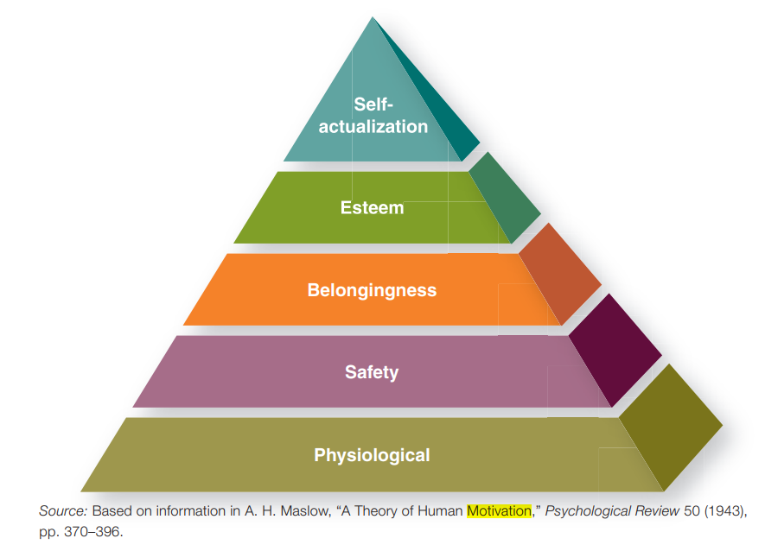

Slide 5
Four-Drive Theory of Motivation
Developed by Harvard Business School professors Paul Lawrence and Nitin Nohria, four-drive theory states that everyone has the drive to acquire, bond, learn, and defend.
These four drives are innate and universal, meaning that they are hardwired in our brains and are found in all human beings. They are also independent of each other.
The Four-Drive Theory provides a comprehensive framework for understanding motivation. By recognizing and addressing these drives, organizations can enhance employee satisfaction and performance.

